Slide 1
Restaurant Reservation Chatbot
Presented By –Ragul S
University College of Engineering Villupuram
B.E CSE (3rd Year)

Slide 2
Problem Statement
Develop a restaurant reservation chatbot capable of assisting users in making reservations, providing information about the restaurant, and handling inquiries related to the menu, operating hours, and special requests. The chatbot should employ a neural network-based model trained on a dataset of intents and responses, enabling it to understand user queries and generate appropriate responses.

Slide 3
Project Overview
The Restaurant Reservation Chatbot project aims to develop an AI-powered system for facilitating restaurant reservations, providing information, and handling inquiries. Using NLP techniques and machine learning, the chatbot interprets user messages, recognizes intents, and generates appropriate responses. Key components include an NLP model, intent recognition system, dynamic response generation, reservation management, user interface, deployment, and testing. The chatbot streamlines reservation processes, enhances customer engagement, and improves the dining experience by offering a user-friendly interface for seamless interaction. It aims to increase customer satisfaction while showcasing the potential of AI in hospitality.

Slide 4
Who Are The End Users?
The end users of the Restaurant Reservation Chatbot include potential customers seeking assistance with table reservations, exploring the menu, and obtaining restaurant information. Additionally, business owners can leverage the technology to enhance customer engagement, streamline operations, and improve service quality, maximizing their business potential.

Slide 5
Our Solution & Its Proposition
Our solution involves developing a tailored chatbot specifically designed for restaurants, emphasizing simplicity and effectiveness. Utilizing basic Python tools like NLTK, our chatbot promptly understands and responds to customer messages. It automates reservation tasks, generating unique booking IDs and reducing errors, thereby streamlining the booking process and improving operational efficiency. Through learning from interactions, our chatbot continually improves, ensuring it remains helpful and relevant over time. Overall, it offers a straightforward and valuable tool for restaurant owners to enhance customer service and streamline operations. We created this chatbot using AI machine learning techniques, initially training the model with a dataset, integrating it with Flask, and designing a user-friendly interface.

Slide 6
The Wow In Our Solution
Visually appealing user interface
Responsive interaction
Accuracy rate achieved
Simple to understand
Simple to use

Slide 7
Modelling
In the modeling process, we start by extracting training data from a JSON file containing intents, patterns, and responses for a wide array of user queries.
To prepare the data for training the neural network model, we employ data preprocessing techniques such as tokenization and stemming, ensuring optimal input for the model.
Our model architecture comprises densely connected layers integrated with activation functions like ReLU and softmax, facilitating precise intent classification and response generation.
During the training phase, we optimize parameters through techniques such as Adam optimization while closely monitoring performance metrics like accuracy to ensure the model's effectiveness.

Slide 8
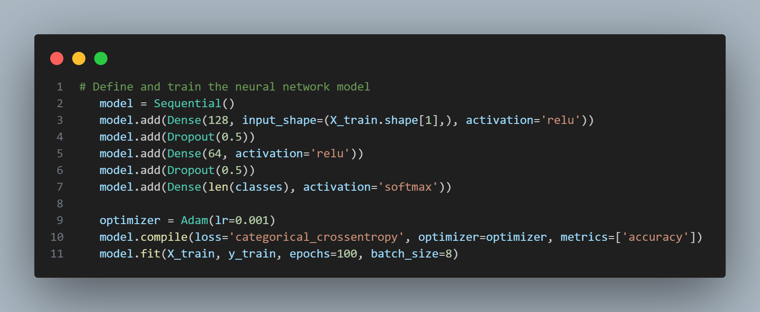
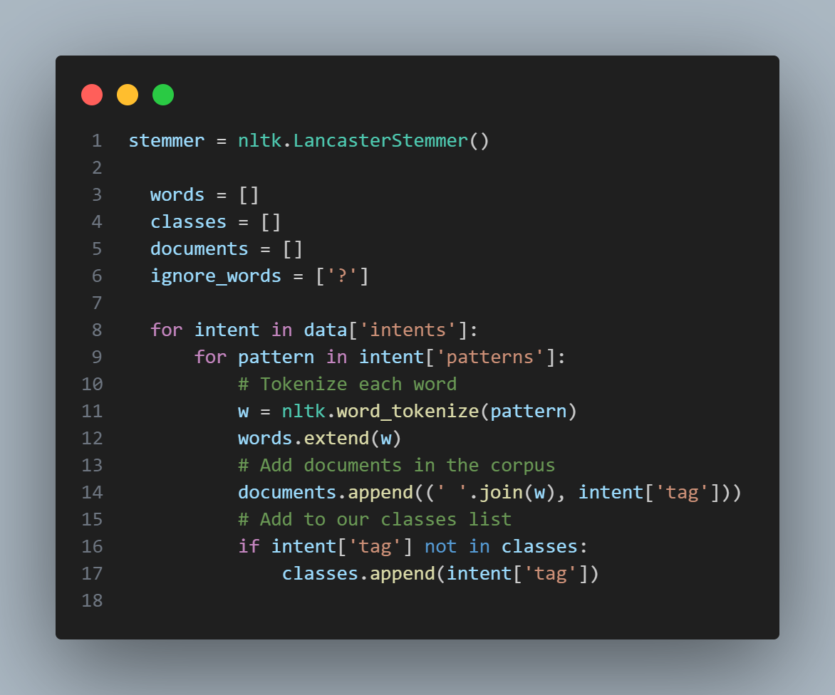
Data Preprocessing

Slide 9
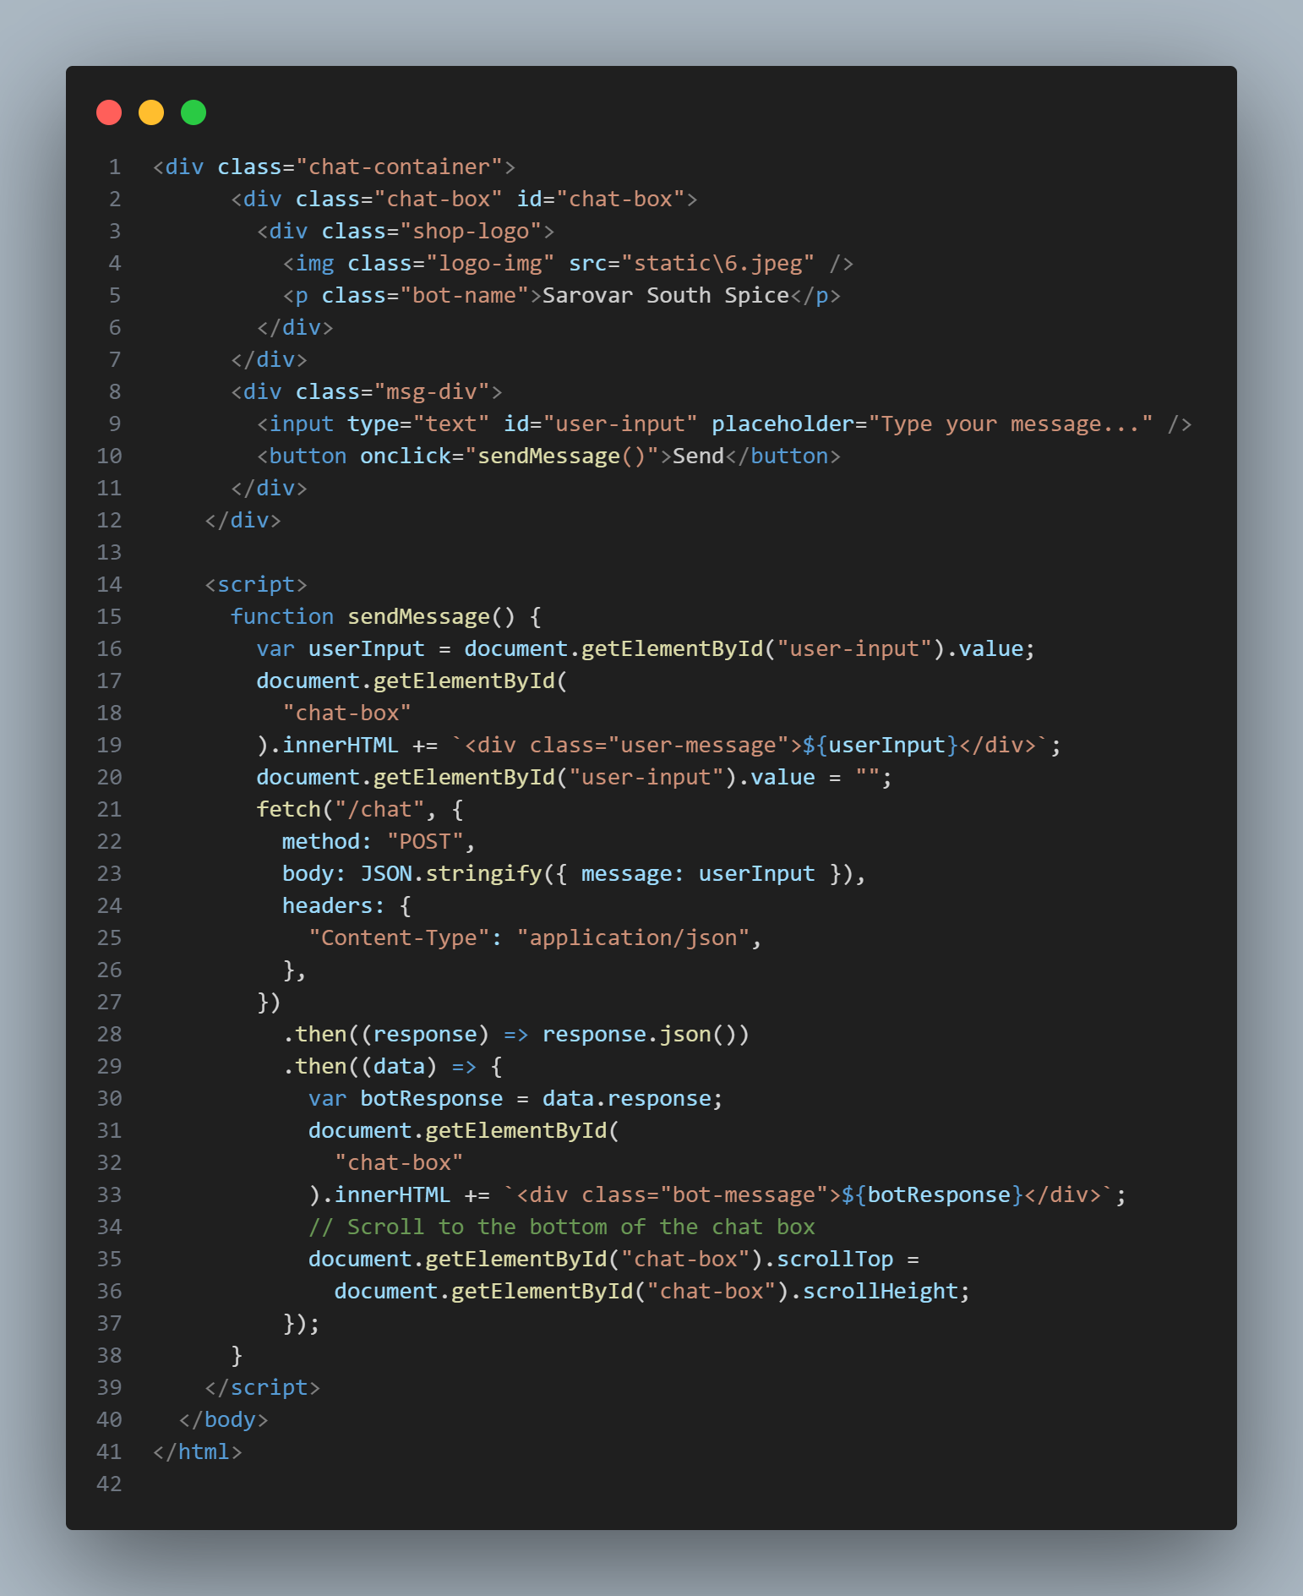
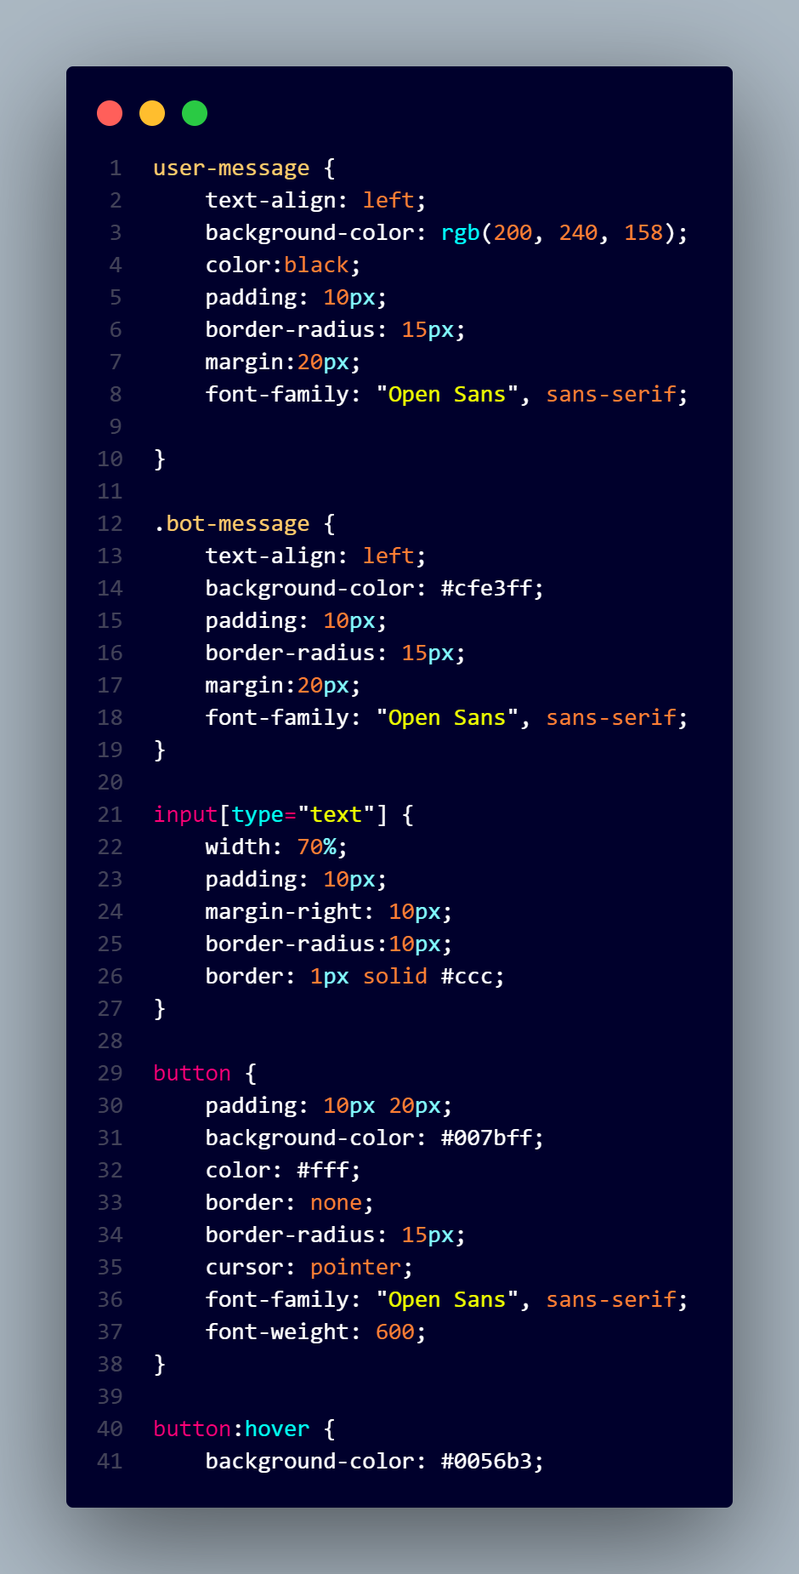
HTML, CSS AND JavaScript for CHATBOT UI

Slide 10
Results
The chatbot consistently delivered accurate responses to a range of user inquiries, earning praise for its reliability.
Users found it effortless to interact with the bot, appreciating its understanding and adept responses to diverse queries.
Benefiting from training on a wide array of conversations, the chatbot seamlessly adapted to different topics and user requirements.
Regular assessments ensured the chatbot's reliability, maintaining a low error rate in its responses.
Continuously learning from interactions, the chatbot progressively improved, effectively meeting the evolving needs of its users.

Slide 11
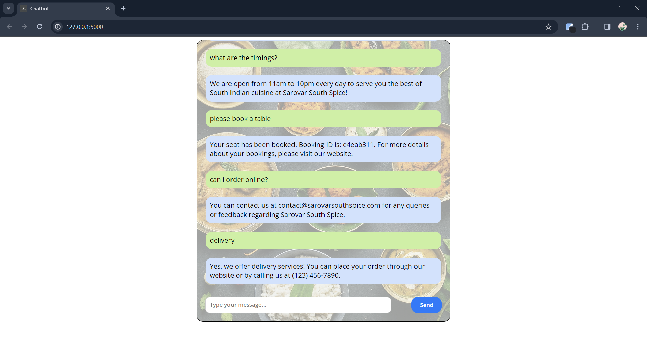
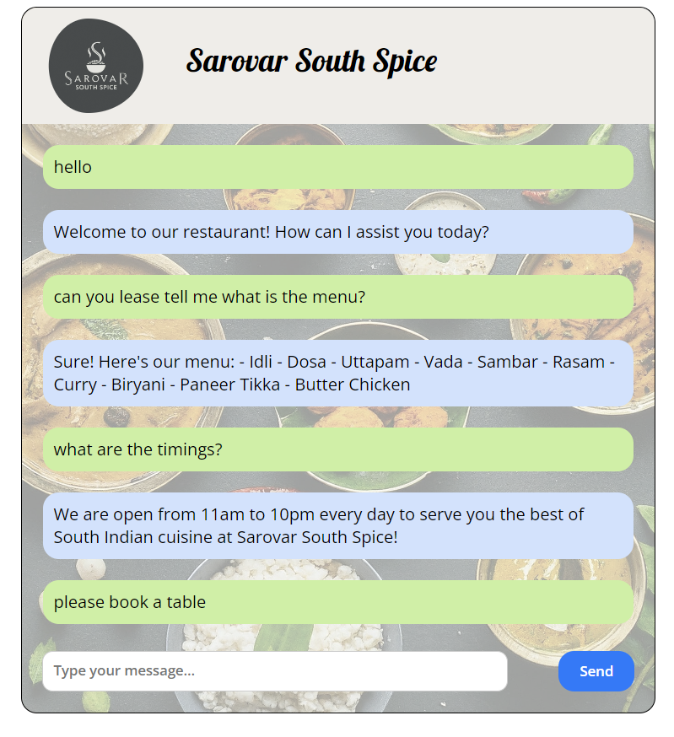

Slide 12
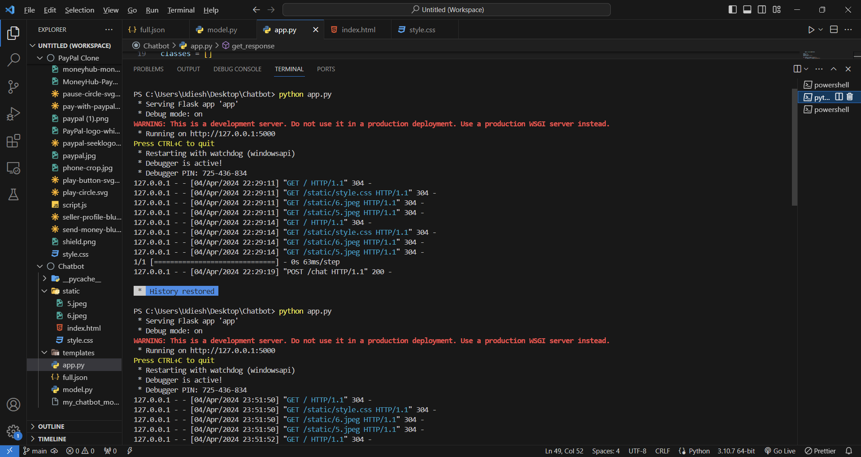
Flask Server Handling the User Query and sending Appropriate Responses Back to the Web Application

